Slide 1



Problem Theme:
Build a Donation Matching Portal
Team 1

Slide 2
Problem Statement brief:
Difficulty finding trusted causes: Donors struggle to find NGOs that align with their values.
Lack of transparency: Donors don't know how their funds are used.
No real-time tracking: Donors can't see the progress of their donations.
Minimal impact reporting: Donors rarely get updates on the real-world effect of their contributions.
Inefficient NGO operations: NGOs have trouble managing and reporting donations.
Weak donor retention: Lack of communication and engagement discourages repeat donations.
2
August 25, 2025

Slide 3
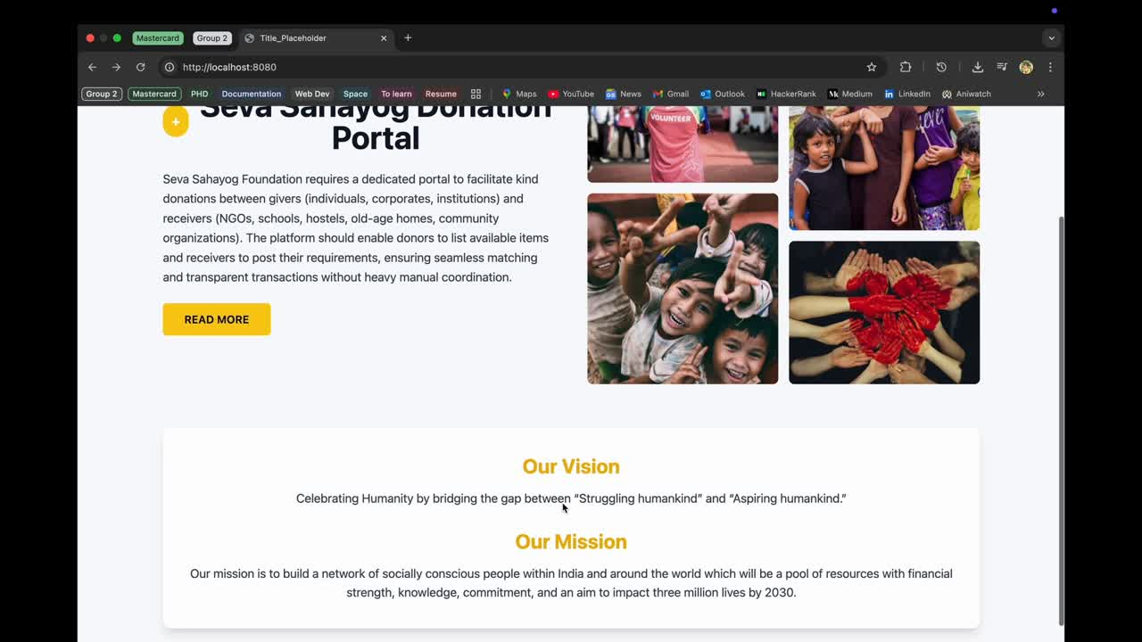

Slide 4
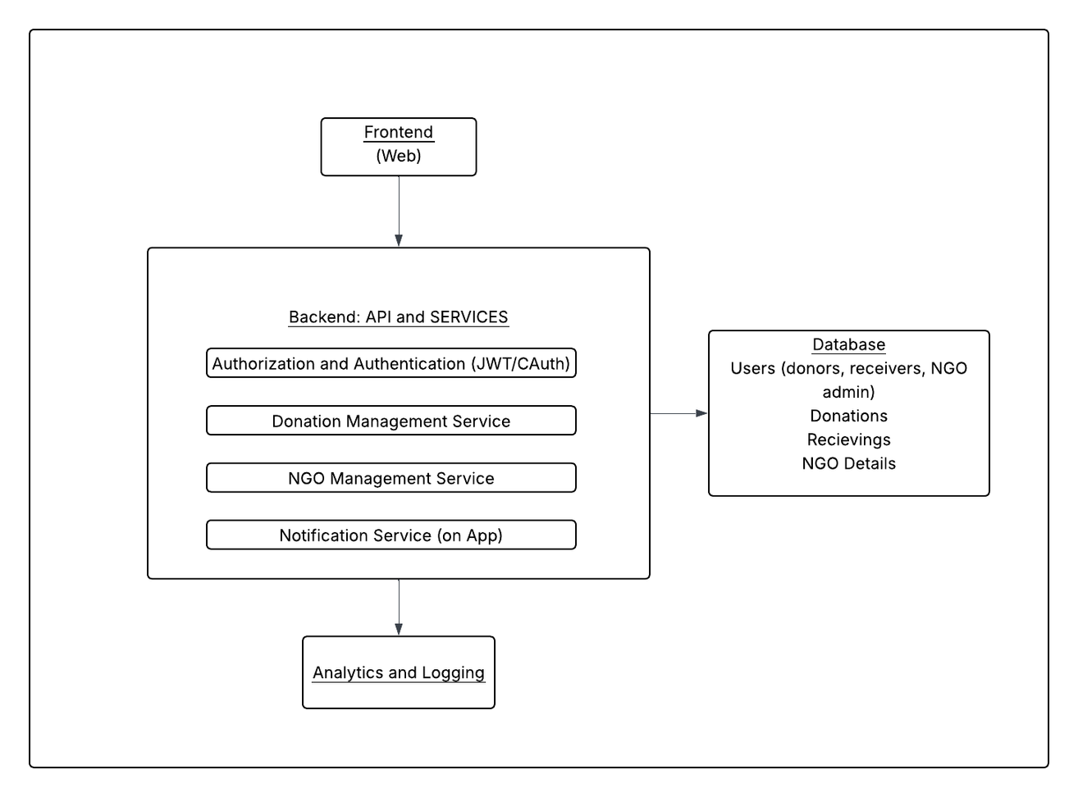
Solution Overview:
3
August 25, 2025

Slide 5
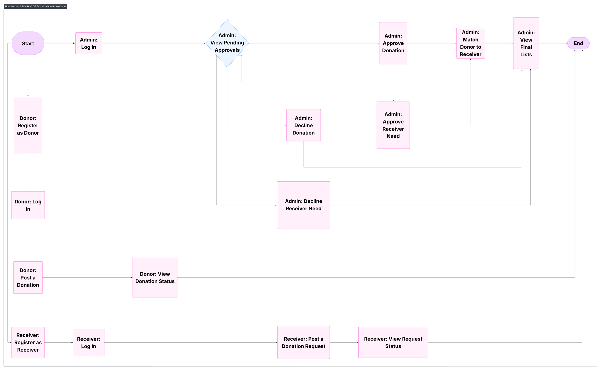
4
August 25, 2025

Slide 6
Technology Stack:
Tech Stack :
Frontend: React.js, TailwindCSS
Backend: NodeJS, ExpressJS, REST APIs
Database: MongoDB (Unstructured Logs/Chat)
Authentication: JWT, OAuth2
AI/ML Layer: OLLAMA, Langchain, Chroma, TensorFlow
Version Control & CI/CD: GitHub, GitHub Actions
Deployment – Vercel and Render
Github link:
https://github.com/Mastercard-Code-For-Change-2-0/Team-1
5
August 25, 2025

Slide 7
Impact/Future scope:
Scalability/Integration:
Microservices with RestAPI → easy scaling per module (donors, recipients, hospitals).
API-first → smooth integration with hospital systems, govt. registries, payment gateways.
Additional Use Cases:
Emergency donor-recipient matching with geolocation. AI-powered health risk scoring & donor eligibility prediction.
Multi-language chatbot for accessibility.
Analytics dashboard for hospitals & NGOs (trends, donor engagement).
Good to Know:
Real-time donor-recipient matching using -
Modular → hospitals, blood banks, NGOs can onboard easily.
Builds trust via transparency, notifications, and audit logs.
6
August 25, 2025

Slide 8
Q&A
7
August 20, 2024

